Slide 1

MBE 713: Marine Population Dynamics Lecture 3: Exponential population growth
Elizabeth A. Babcock

Slide 2
What limits populations?
Density dependence* means that as the population grows larger, the population growth rate decreases, e.g.
Higher mortality rates at higher populations,
Lower growth at higher populations
* Also called compensation

Slide 3
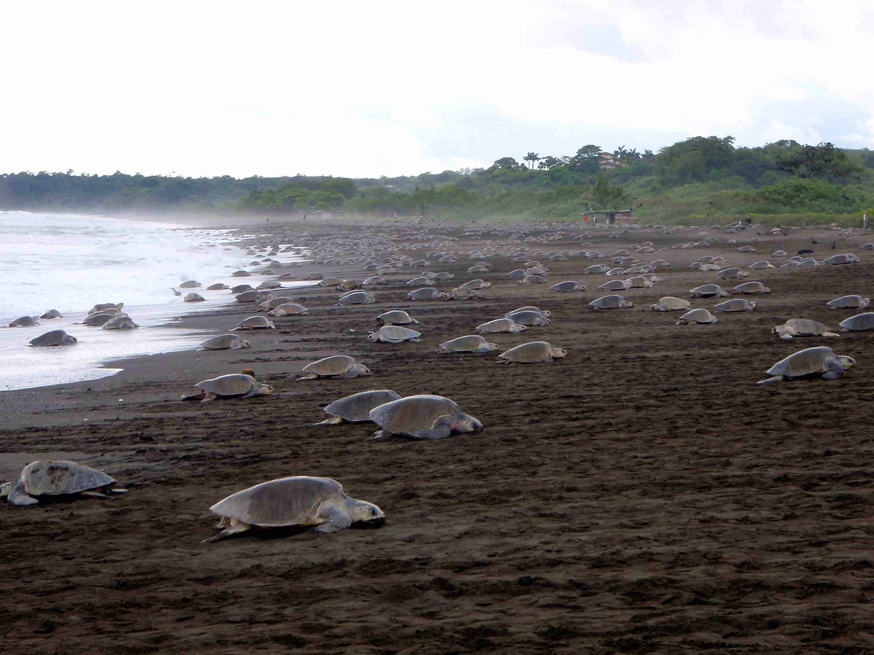
Examples: Olive’s ridley Costa Rica
Higher population means new females arriving at nesting sites dig up old nests. Eggs produced per female decreases
https://www.crcdaily.com/p/the-incredible-sea-turtle-arribadas

Slide 4
Examples
Pacific salmon and other fish also have nest disruption at high density
Many species expanded into worse habitat at higher population sizes, leading to slower growth, or more mortality (Ideal free distribution)
Animals starve if they eat all their food species (e.g. grazing animals)
Limits in refugia from predators, e.g. for reef fish.
More diseases or parasites with higher abundance- shown in fish in marine reserves

Slide 5
How to model density dependence?
Carrying capacity (K) is the hypothetical population that a habitat can support
Assume the population growth rate (r) decreases as a fraction of the maximum growth rate r_{m} the population approaches K.

Slide 6
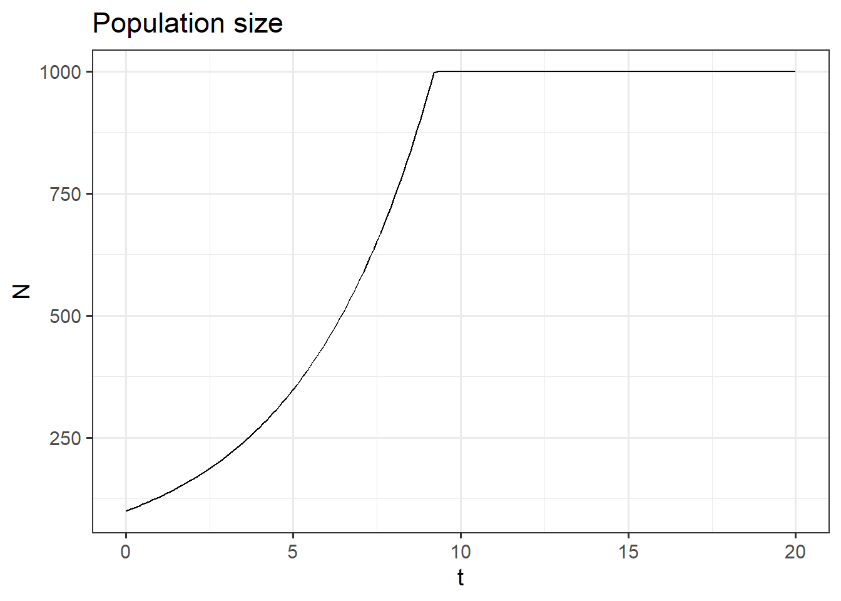
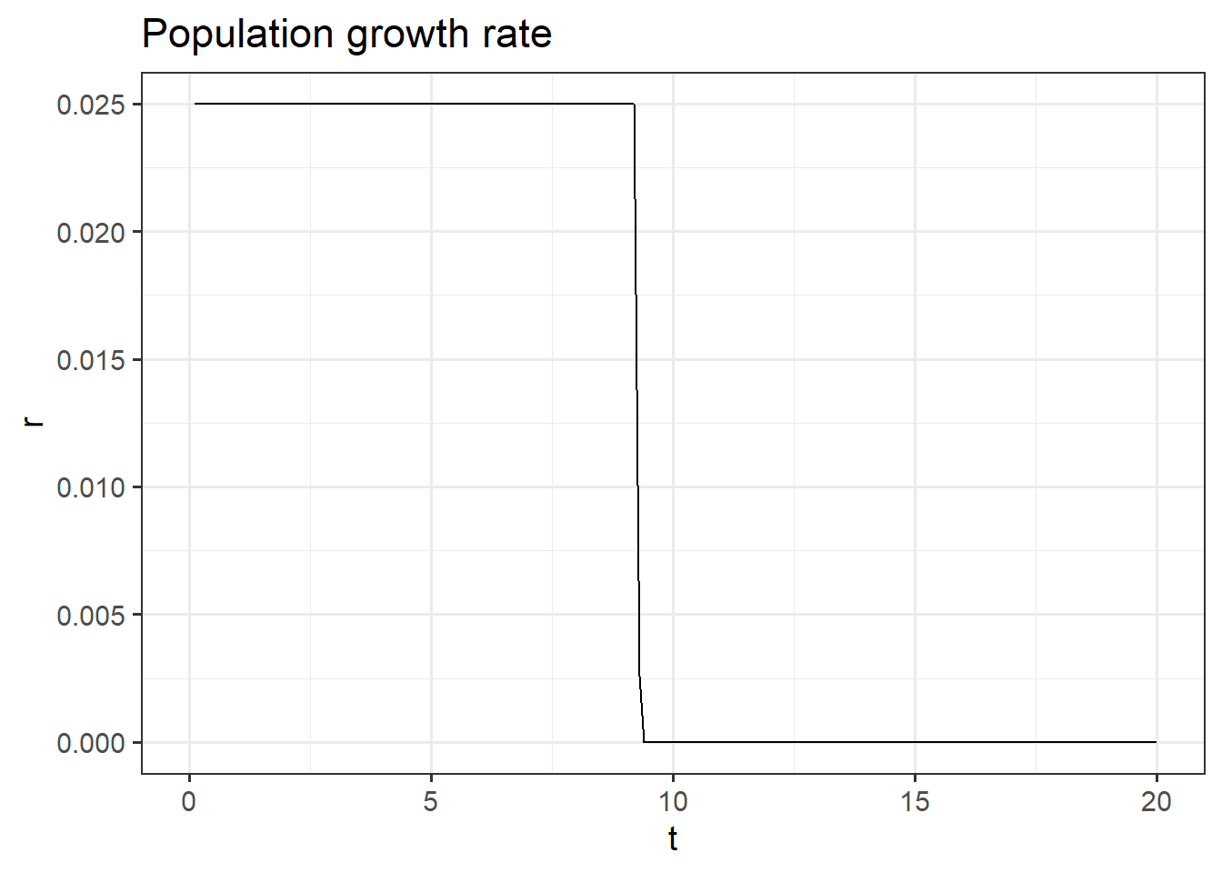
Naïve way to model carrying capacity
Assume that the growth rate does not change with density, but all animals after animal K die.

Slide 7
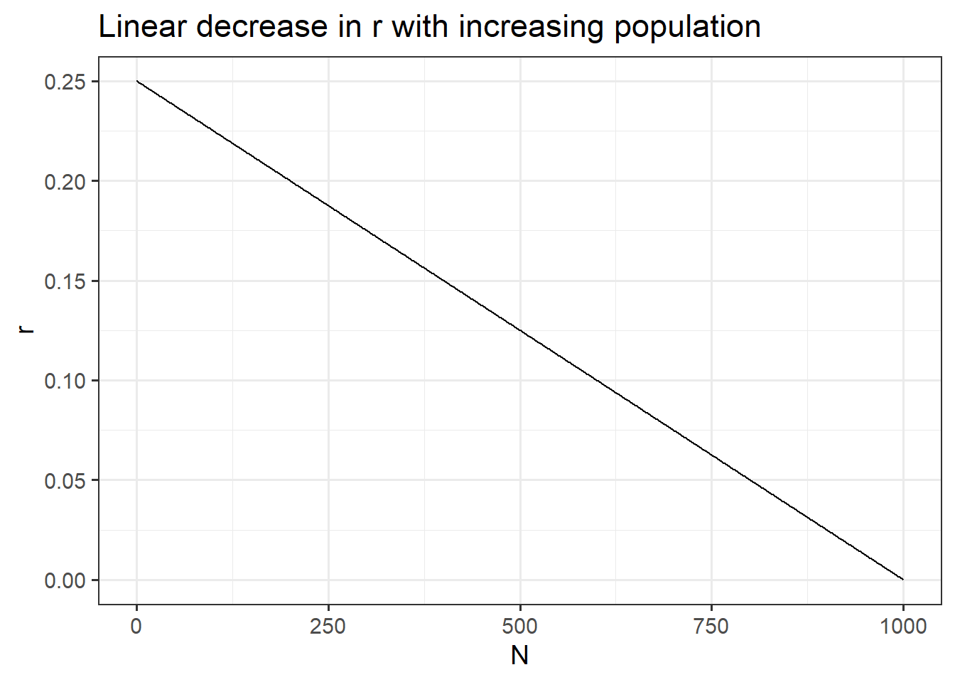
Linear decrease in r

Slide 8
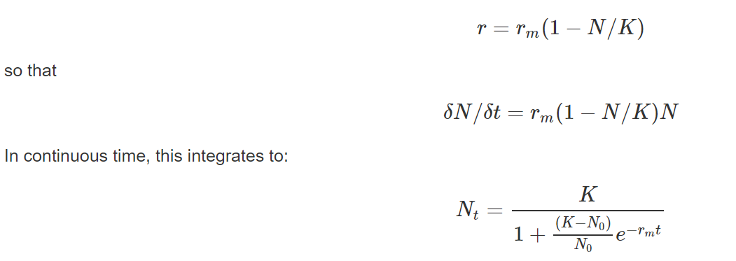
Derivation of numbers with constant r_{m}

Slide 9
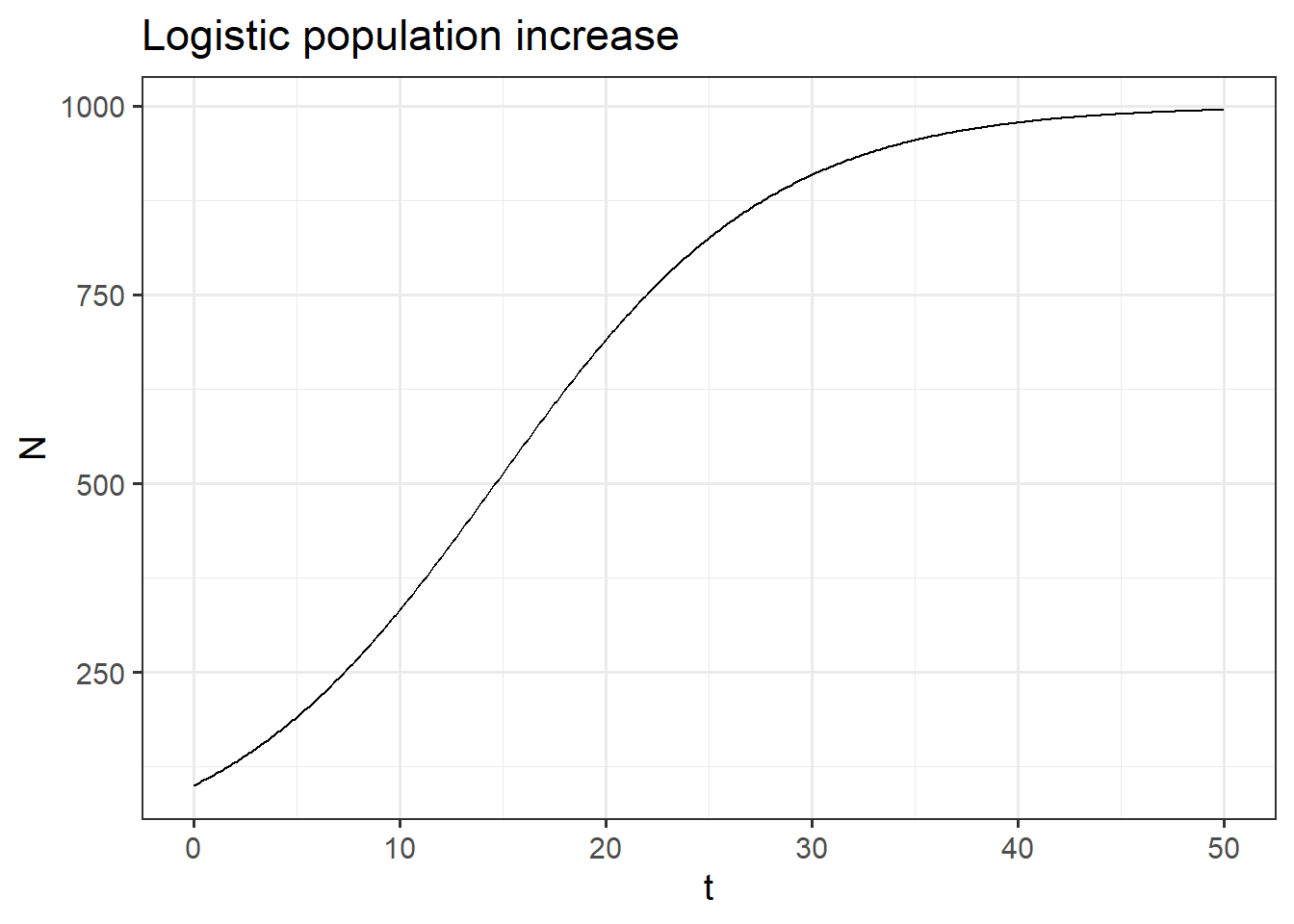

Slide 10
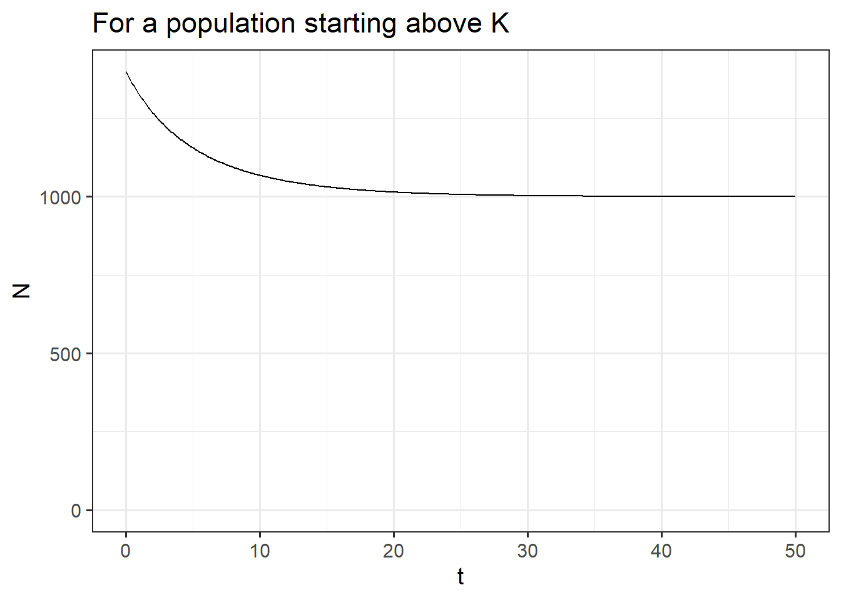

Slide 11

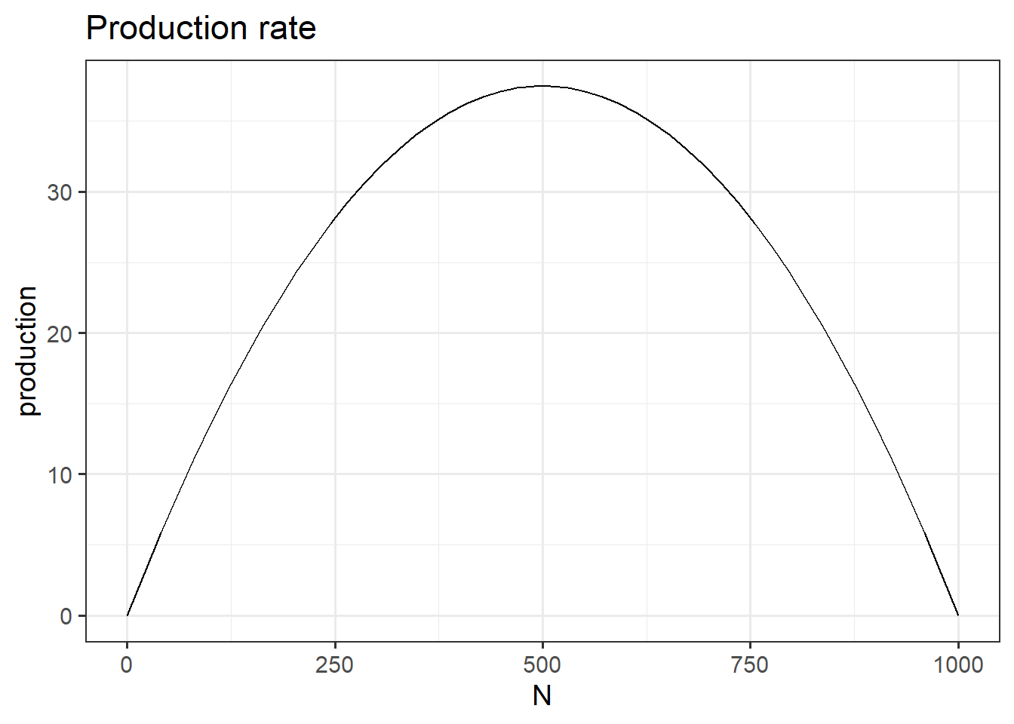

Slide 12
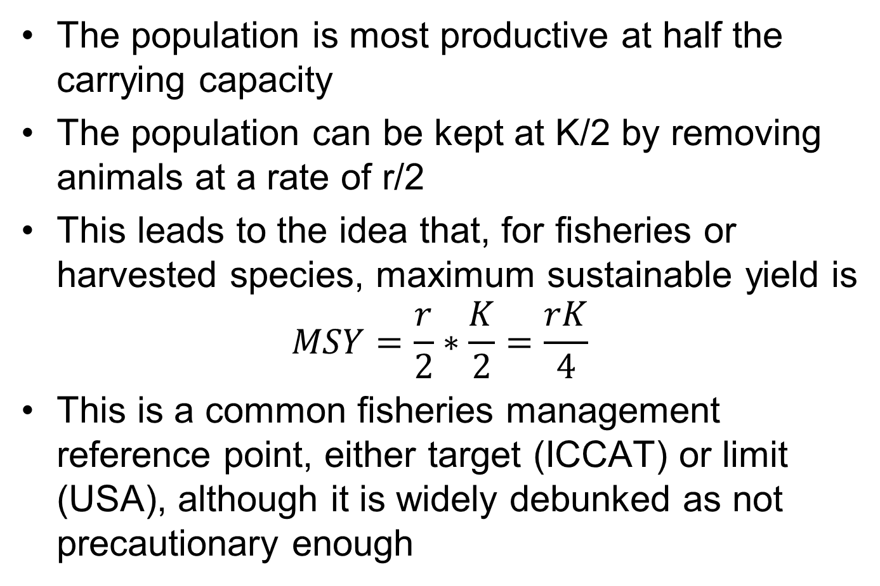
Maximum sustainable yield
The population is most productive at half the carrying capacity
The population can be kept at K/2 by removing animals at a rate of r/2
This leads to the idea that, for fisheries or harvested species, maximum sustainable yield is
$$MSY=\frac{r}{2}∗\frac{K}{2}=\frac{rK}{4}$$
This is a common fisheries management reference point, either target (ICCAT) or limit (USA), although it is widely debunked as not precautionary enough

Slide 13
Logistic model in fisheries
The logistic population growth model is the simplest population dynamics model used for fisheries management.
Called Schaefer Surplus Production model
Modern assessments tend to use the discrete time version, and often use biomass rather than N in the equation.
Fisheries scientists confusingly use r to mean the intrinsic population growth rate in either continuous time (r_{m}) or discrete time (R_{m}), for either numbers or biomass

Slide 14
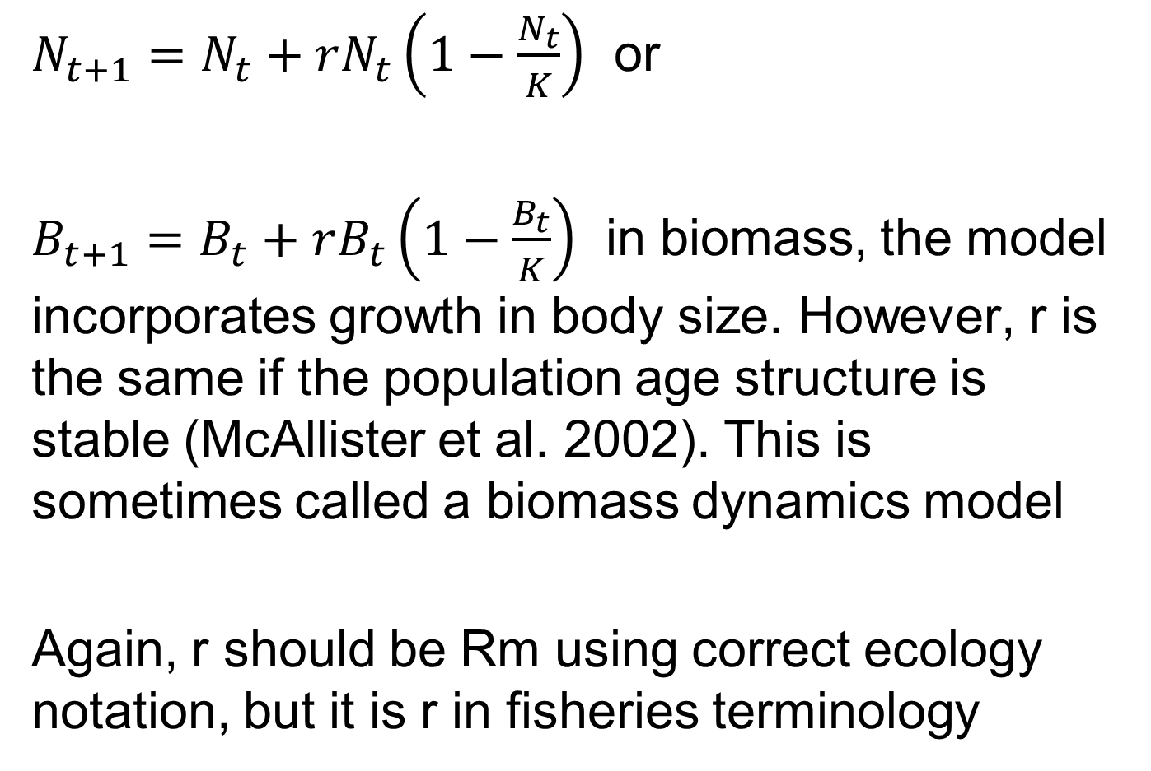
Discrete time version
$N_{t+1}=N_{t}+rN_{t}\left(1−\frac{N_{t}}{K}\right)$ or
$B_{t+1}=B_{t}+rB_{t}\left(1−\frac{B_{t}}{K}\right)$ in biomass, the model incorporates growth in body size. However, r is the same if the population age structure is stable (McAllister et al. 2002). This is sometimes called a biomass dynamics model
Again, r should be Rm using correct ecology notation, but it is r in fisheries terminology

Slide 15
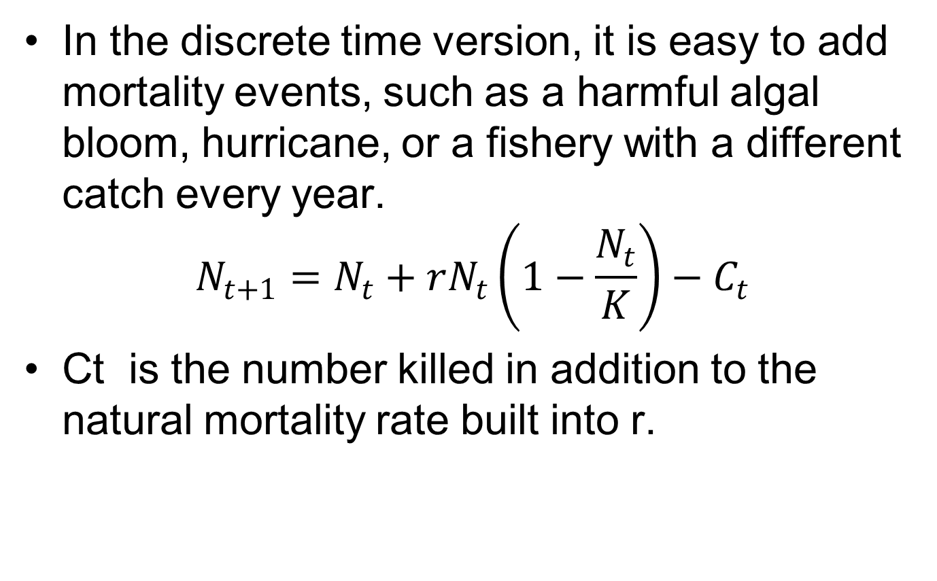
Adding mortality events
In the discrete time version, it is easy to add mortality events, such as a harmful algal bloom, hurricane, or a fishery with a different catch every year.
$$N_{t+1}=N_{t}+rN_{t}\left(1−\frac{N_{t}}{K}\right)−C_{t}$$
Ct is the number killed in addition to the natural mortality rate built into r.

Slide 16
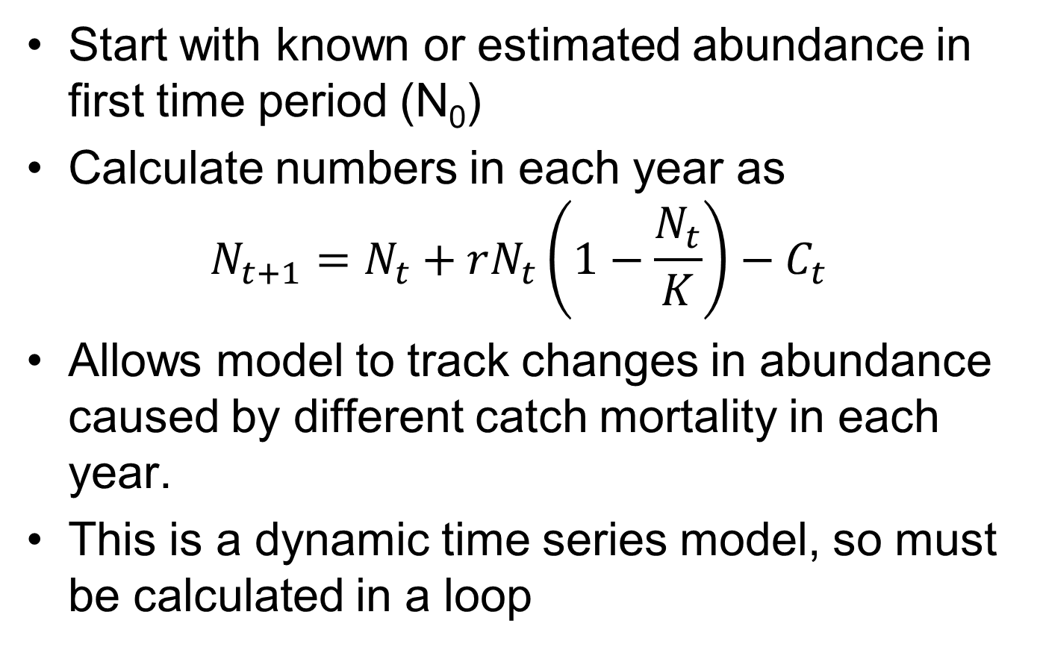
Calculating time series of N
Start with known or estimated abundance in first time period (N₀)
Calculate numbers in each year as
$$N_{t+1}=N_{t}+rN_{t}\left(1−\frac{N_{t}}{K}\right)−C_{t}$$
Allows model to track changes in abundance caused by different catch mortality in each year.
This is a dynamic time series model, so must be calculated in a loop

Slide 17
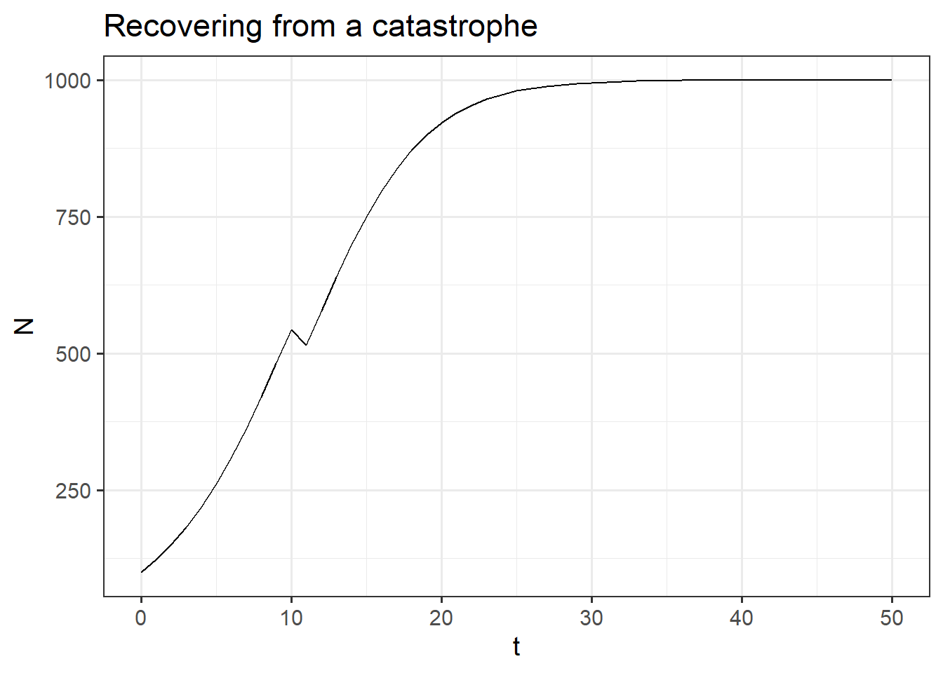

Slide 18

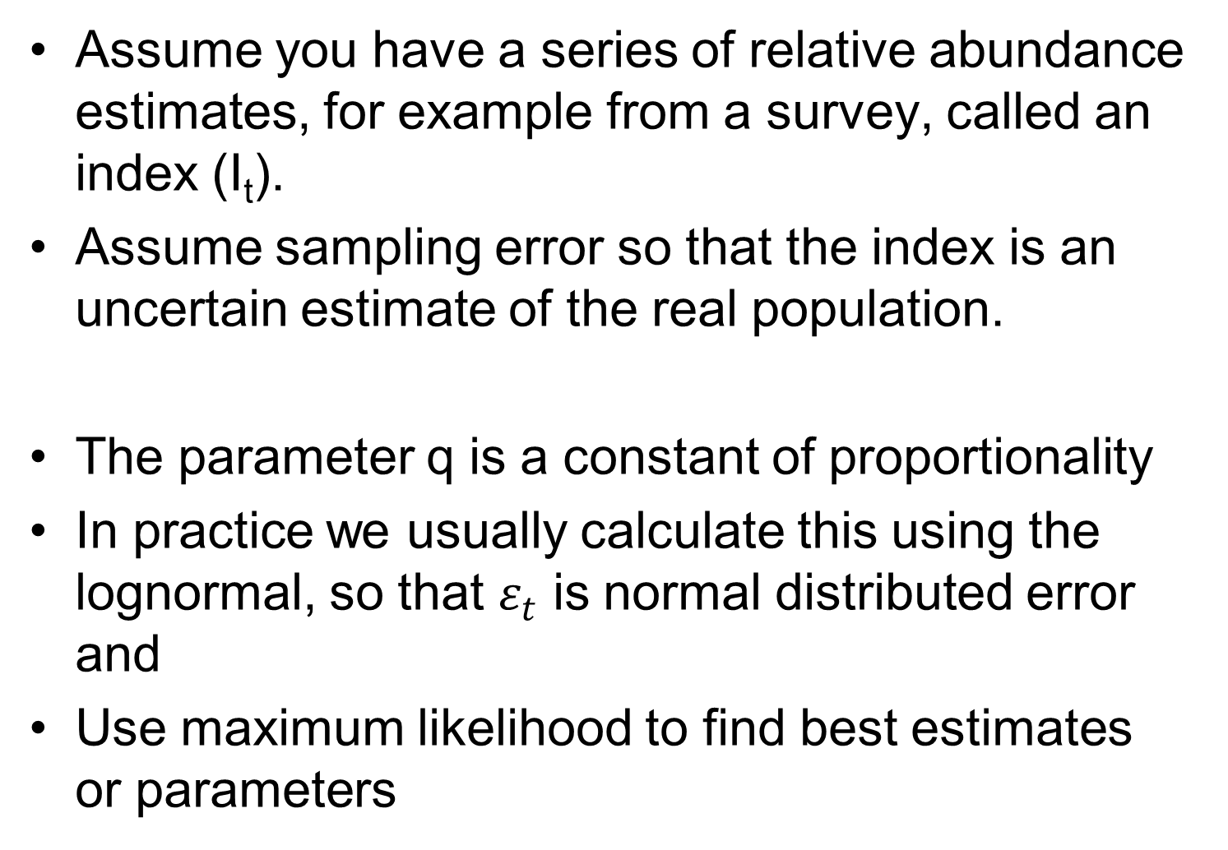

Fitting model to data
Assume you have a series of relative abundance estimates, for example from a survey, called an index (I_{t}).
Assume sampling error so that the index is an uncertain estimate of the real population.
The parameter q is a constant of proportionality
In practice we usually calculate this using the lognormal, so that $ε_{t}$ is normal distributed error and
Use maximum likelihood to find best estimates or parameters
$$I_{t}={qN}_{t}+error$$
$${log⁡(I}_{t})={log⁡(qN}_{t})+ε_{t}$$

Slide 19
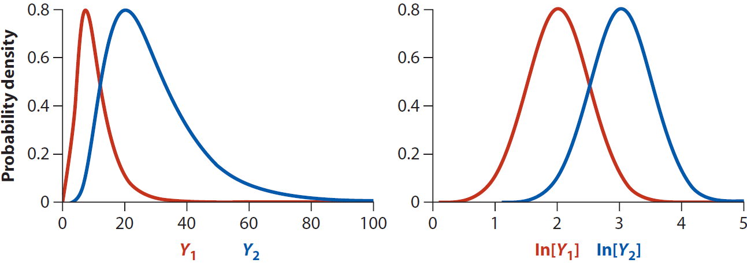
log transformation of lognormal data
If Y is lognormal, X=log(Y) is normal

Slide 20
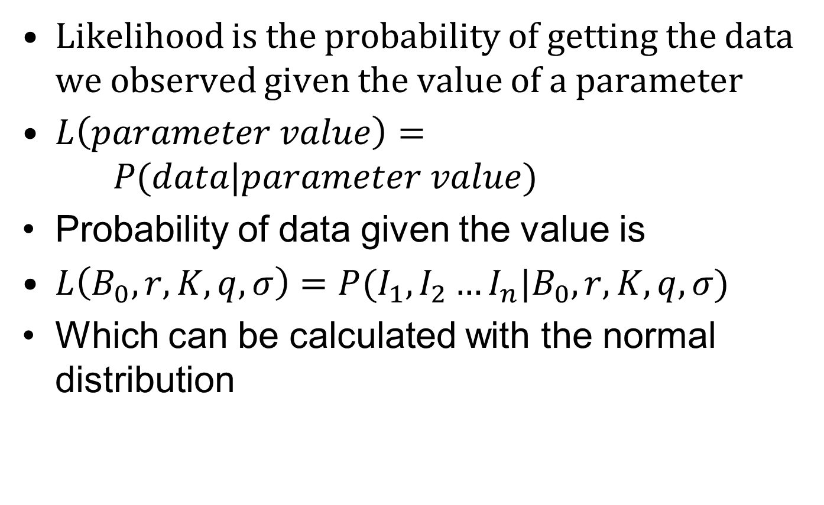
Maximum Likelihood Estimation
Likelihood is the probability of getting the data we observed given the value of a parameter
$L\left(parameter value\right)= P(data|parameter value)$
Probability of data given the value is
$L\left(B_{0},r,K,q,σ\right)=P(I_{1},I_{2}…I_{n}|B_{0},r,K,q,σ)$
Which can be calculated with the normal distribution

Slide 21
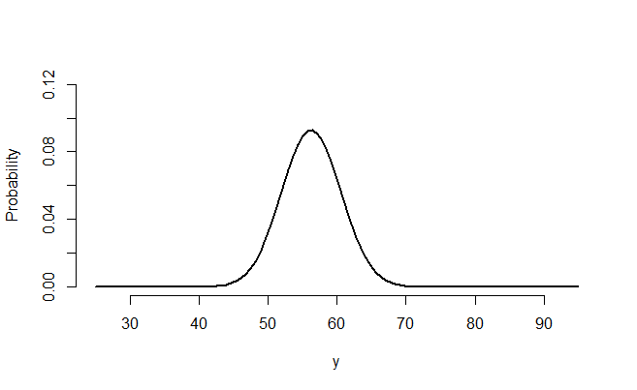
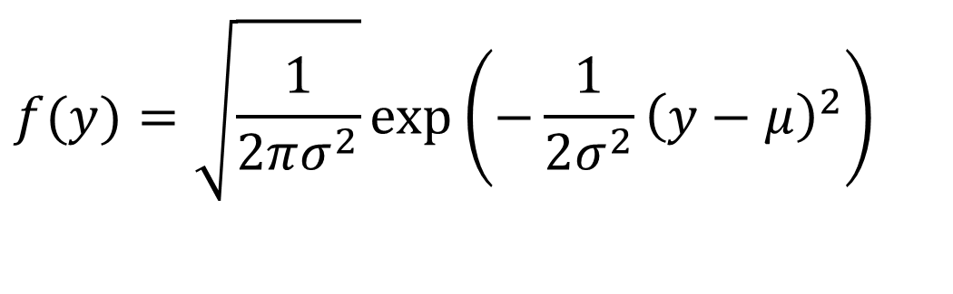

Normal likelihoods
Normal. y is log(I), $μ$ is log(qB)
In R, use dnorm() or dlnorm
$$f(y)=\sqrt{\frac{1}{2πσ^{2}}}\exp\left(−\frac{1}{2σ^{2}}{\left(y−μ\right)}^{2}\right)$$

Slide 22
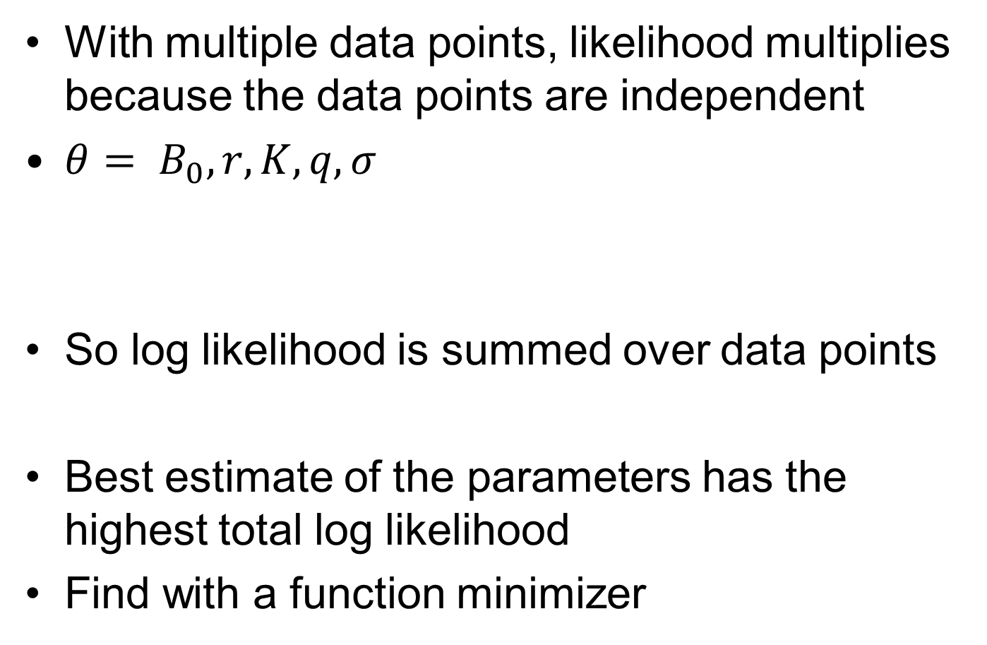
Likelihood with multiple data points
With multiple data points, likelihood multiplies because the data points are independent
${θ= B}_{0},r,K,q,σ$
So log likelihood is summed over data points
Best estimate of the parameters has the highest total log likelihood
Find with a function minimizer
$$L\left(θ\right)=P\left(y_{1},y_{2},…y_{n} | θ\right)=P\left(y_{1} | θ\right)∗ P\left(y_{2} | θ\right)… P\left(y_{n} | θ\right)$$
$$log⁡(L\left(θ)\right)=\log\left(P\left(y_{1} | θ\right)\right)+log\left( P\left(y_{2} | θ\right)\right)…$$

Slide 23
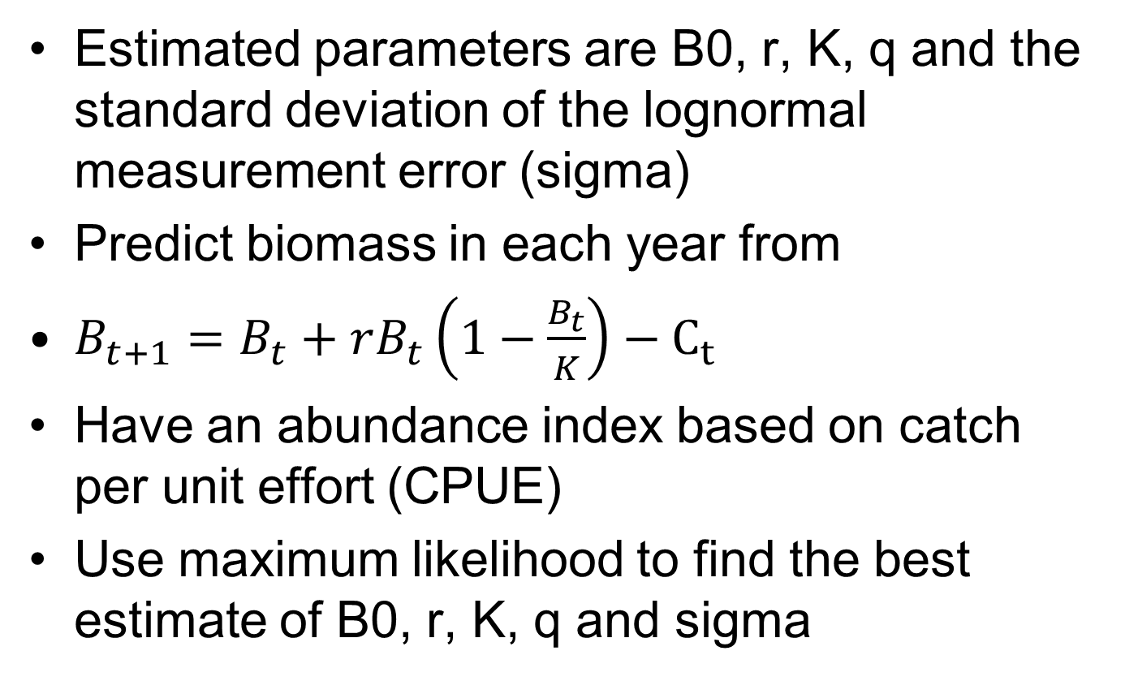
Fisheries example (swordfish biomass)
Estimated parameters are B0, r, K, q and the standard deviation of the lognormal measurement error (sigma)
Predict biomass in each year from
$B_{t+1}=B_{t}+rB_{t}\left(1−\frac{B_{t}}{K}\right)−C_{t}$
Have an abundance index based on catch per unit effort (CPUE)
Use maximum likelihood to find the best estimate of B0, r, K, q and sigma

Slide 24
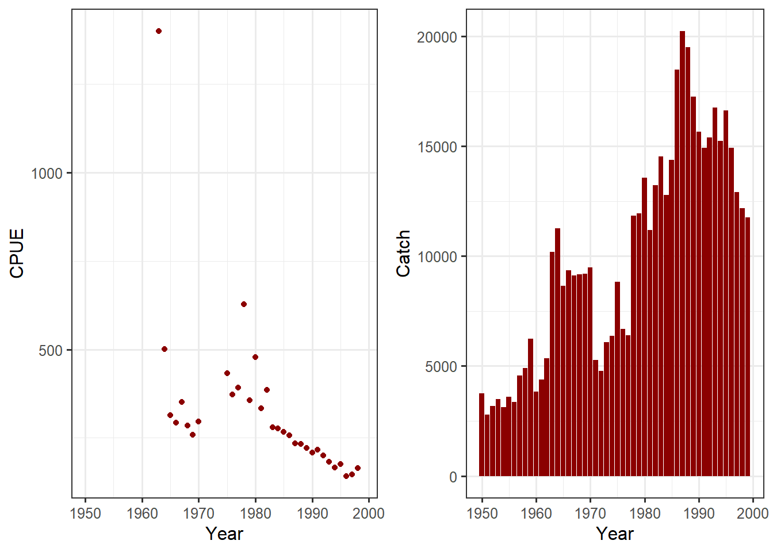
Data for swordfish

Slide 25
Maximum likelihood in R
Write a function that calculates the negative of the total log likelihood, taking a vector of the parameters and the data as inputs
Use a minimization function in R to find the best estimate.
Constrain the parameters to be in the correct range (e.g. not negative).
Estimate log(K) not K because it works better

Slide 26
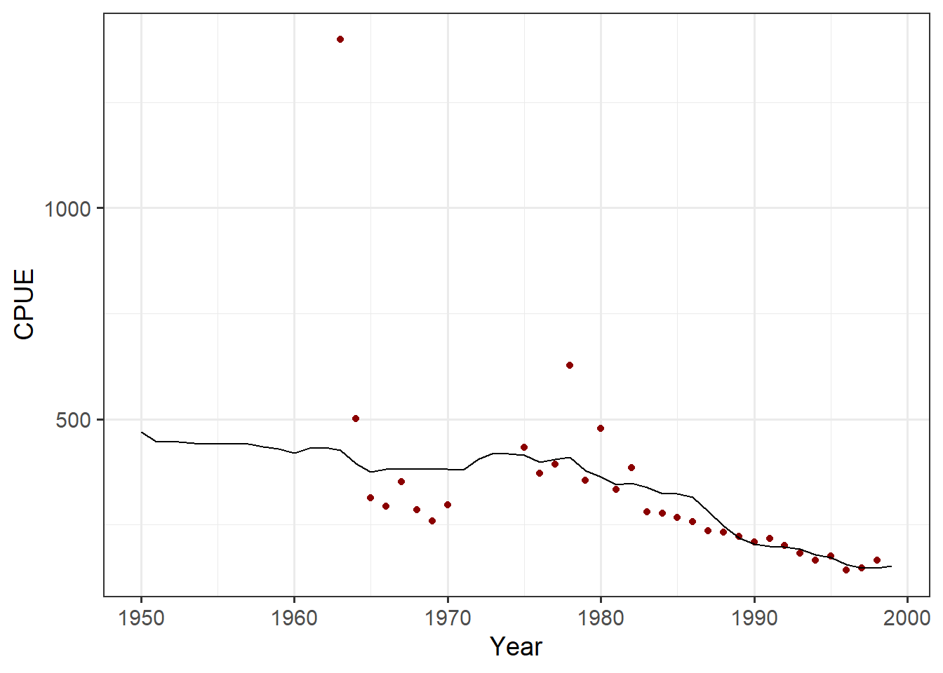
Model fit

Slide 27
Additional Readings and resources
https://elizabeth-babcock.shinyapps.io/ProductionModelDemo3/

